Slide 1
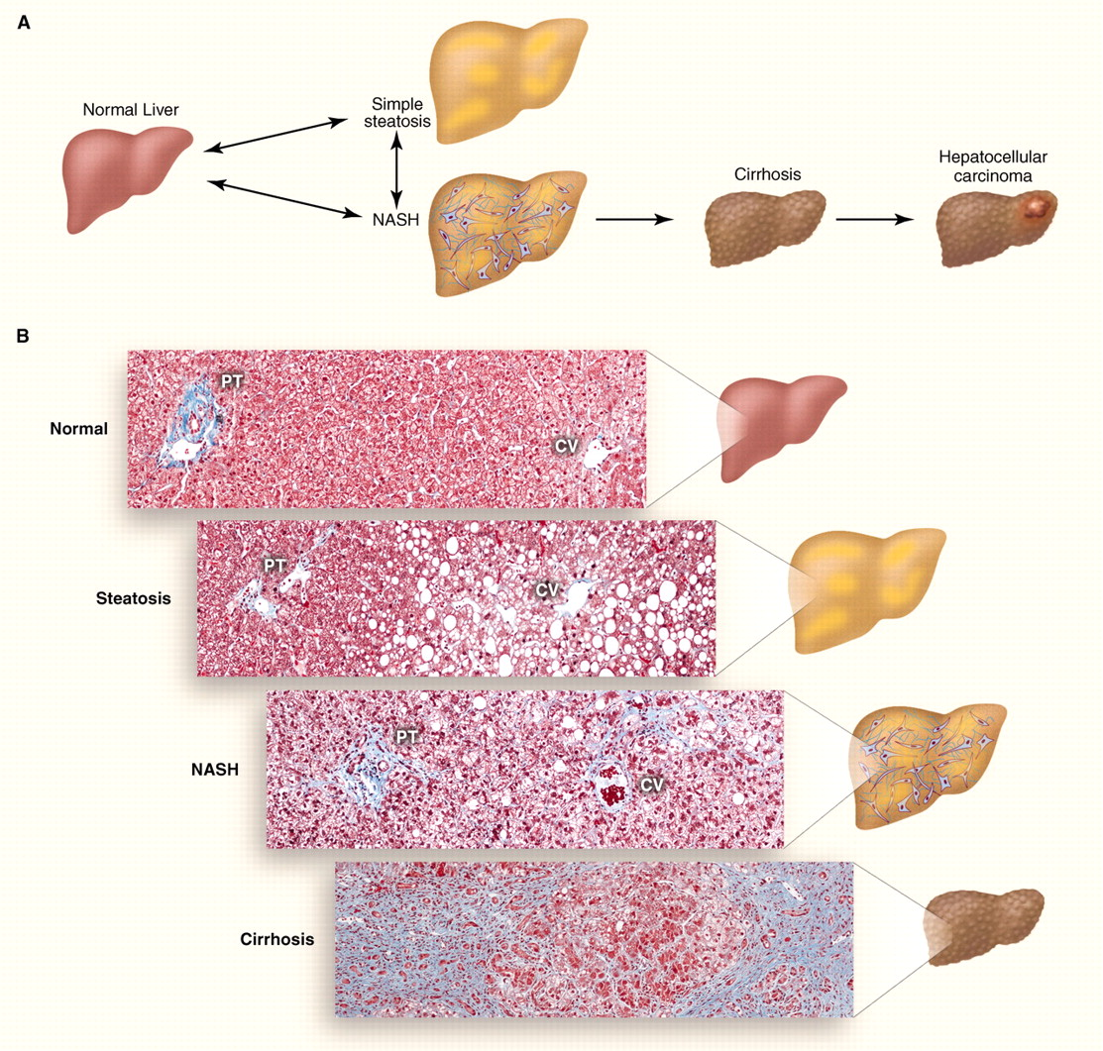
A cost-utility analysis of treatments for NAFLD/NASH
Figure from Cohen JC, Horton JD, Hobbs HH. Human Fatty Liver Disease: Old Questions and New Insights. Science. 2011;332:1519-1523.

Slide 2
The histopathological spectrum of non-alcoholic fatty liver disease
Figure from Cohen JC, Horton JD, Hobbs HH. Human Fatty Liver Disease: Old Questions and New Insights. Science. 2011;332:1519-1523
Notes:
Gold standard for diagnosis of NAFLD (and other chronic liver diseases) is liver biopsy – a safe but invasive and expensive procedure where tissue is harvested and examined by a trained histopathologist under a microscope
-Another topic of discussion: development of prognostic biomarkers which reduce the need for biopsy and their PE analyses
Simple steatosis: accumulation of fat in the liver when excessive alcohol intake is ruled out, at least 5% of cells must display this fat deposition, considered a mild condition given there is no evidence long term mortality risk increase
NASH (Non-alcoholic steatohepatitis): accumulation of fat in the liver leading to inflammation and cell damage
In the American Association for the Study of Liver Diseases (AASLD) Practice Guidelines, NAFL is defined as the presence of hepatic steatosis with no evidence of hepatocellular injury (ballooning of the hepatocytes), whereas NASH comprises the presence of hepatic steatosis plus inflammation with ballooning, with or without fibrosis
In fact, several definitions of NASH have been proposed
The emphasis on ballooning rather than fibrosis is important for why I did not choose to include NASH as a disease state in my model
Fibrosis: scarring (excessive fibrous tissue) in the inflamed liver, stages 0-4 (mild, moderate, advanced) based on extent/distribution
Cirrhosis: Late stage chronic liver disease, characterized by nodules of damaged liver cells surrounded by scarring

Slide 3
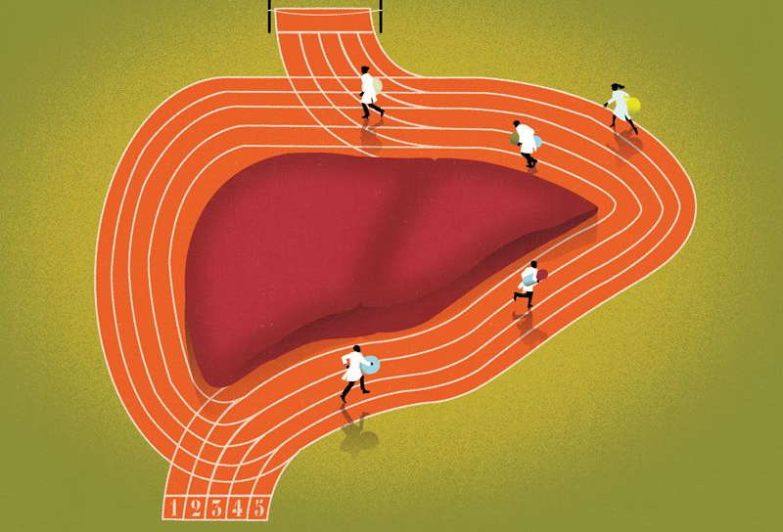
For drug-makers: An opportunity
Exploding disease population
Comorbid with obesity and type 2 diabetes
Expensive sequelae
NASH is projected to become the leading indication for liver transplant by 2020
Opportunities to demonstrate cost-effectiveness and possibly cost-savings
No current FDA-approved treatments
Drew L. Drug development: Sprint finish. Nature. 2017;551.
Notes:
Many of the same drug makers that developed the blockbuster Hep C treatments are interested in developing NASH drugs, with investors asking “what’s next?” following market saturation
However, NAFLD/NASH has proved harder to treat than Hep C for several reasons – including difficulty in finding clinically meaningful results from short term clinical trials (1-2 years)
Financial analysts predict that by 2025, the drug market for NAFLD and NASH will be worth $20 billion to $35 billion a year
-In January 2014, Intercept Pharmaceuticals announced that it had stopped a phase II clinical trial almost one year early. The interim analysis showed that a 72-week course of a synthetic bile acid, obeticholic acid, was clearly working to reduce inflammation and scarring. On the day of the announcement, New York-based Intercept’s stock price almost quadrupled; and by the week’s end it had nearly doubled again. OCA is a Farnesoid X Receptor agonist
-One year later in 2015, Merck shook hands on a $450-million deal with NGM Biopharmaceuticals for their NAFLD therapeutic drugs, including an engineered version of the hormone FGF19, which mediates Farnesoid X Receptor (FXR) signaling (activation reduces insulin resistance, and lipid synthesis)
-Gilead Sciences agreed to pay Phenex Pharmaceuticals of Germany, up to $470 million for its Farnesoid X Receptor (FXR) small molecule agonists drug development program including GS-9674,.
In 2016, the deals continued.
-Gilead purchased a subsidiary of biotechnology company Nimbus Therapeutics, for an initial $400 million, up to $1.2 bill, for GS-0976, an acetyl-coA carboxylase (ACC) which blocks de novo lipogenesis in the liver. Gilead is now studying GS-0976, GS-9674, and selonsertib in various combinations in the ongoing ATLAS trial.
-Allergen went on a buying spree acquiring multiple NASH developmental products including Tobira Therapeutics and its NAFLD candidate drugs for $1.69 billion. Evogliptin, a DPP-4, and Cenicriviroc (CVC) was acquired as a part of this deal. CVC was acquired on the heels of the results of a promising Phase 2b proof-of-concept trial CENTAUR (discussed next slide)
Compared with the frenetic pace of the past few years, 2017 was quiet
Even so Novartis has paid Conatus Pharmaceuticals an initial $50 million up to $650 mill, to develop Conatus’s lead NAFLD drug, emricasan, a pan-caspase inhibitor (antiapoptotic, anti-inflammatory) which targets NASH patients with decompensated cirrhosis.

Slide 4
The NASH pipeline – Phase 3
OBETACHOLIC ACID (Intercept)
semi-synthetic derivative of human bile acid CDCA – functions as farnesoid X receptor agonist
Previously evaluated in the FLINT trial and by Mudaliar et al., 2013
35% of patients in the treatment arm vs. 19% in the placebo arm had improvements in fibrosis, p = 0.004 (defined as regression of ≥1 stage in fibrosis score)
Cardiovascular risks must be further characterized due to elevations in LDL and decreases in HDL
Now being assessed in a large (~2,000 patient) 6 year phase III clinical trial – REGENERATE
Targeting NASH patients with Stage 2-3 fibrosis
Primary outcomes are fibrosis improvement, NASH resolution, progression to cirrhosis, ascites, HCC, liver transplantation
ALSO recently (December) announced the REVERSE trial
Targeting patients with compensated cirrhosis with fibrosis score of 4
ELAFIBRANOR (Genfit)
Previously evaluated in the GOLDEN-505 trial by Ratziu et al., 2016
Now being investigated in a large (~2,000 patient), 4 year phase III clinical trial – RESOLVE-IT
Treatment will last until achievement of pre-specified number of outcomes including all-cause mortality, cirrhosis development, and liver-related clinical outcomes
Konerman MA, Jones JC, Harrison SA. Pharmacotherapy for NASH: Current and emerging. Journal of Hepatology. 2018;68:362-375.
Notes:
As of summer 2018, there are 48 NASH drugs in clinical trials: 14 at Phase 1, 30 at Phase 2, and 4 at Phase 3
<https://www.biopharmadive.com/news/nash-drug-pipeline-market-liver-disease/523492/>
OBETICHOLIC ACID (OCA) - In the FLINT trial, 45% of patients in the treatment arm had at least a 2-point improvement in the NAS without worsening of fibrosis, compared to only 21% in the placebo arm (p = 0.0002). Of note, the proportion of patients who achieved resolution of NASH (defined as either not NAFLD or NAFLD but not NASH) was not statistically different (22% for OCA vs. 13% for placebo, p = 0.08). Interestingly, OCA did have a beneficial impact on fibrosis (35% of patients in the treatment arm vs. 19% in the placebo arm had improvements in fibrosis, p = 0.004)
Elafibranor significantly decreased total cholesterol, LDL-cholesterol, triglycerides, and increased HDL-cholesterol, and significantly improved glucose homeostasis (significant reductions in HbA1c and free fatty acids in diabetic patients

Slide 5
The NASH pipeline – Phase 3 cont
CENICRIVIROR (CVC)
dual CCR2/CCR5 chemokine receptor antagonist
Previously evaluated in phase IIb, international study of patients with NASH – Friedman et al, 2017
twice as many patients in the CVC arm had improvement in fibrosis by ≥1 stage without worsening in steatohepatitis
Now undergoing further investigation for impact on fibrosis in a 12-month phase III clinical trial of patients with NASH and stage 2-3 fibrosis – AURORA trial
SELONSERTIB
an apoptosis signal-regulating kinase which mediates oxidative stress related cell death, inflammation, and fibrosis
Recent Phase II trial evaluated change in fibrosis are primary endpoint
2 New phase III clinical trials – STELLAR 3 and STELLAR 4 are studying the effect on fibrosis, in patients with bridging fibrosis
There are currently more than 200 active trials of NAFLD treatments
Konerman MA, Jones JC, Harrison SA. Pharmacotherapy for NASH: Current and emerging. Journal of Hepatology. 2018;68:362-375.
Notes:
CENICRIVIROR (CVC) No difference in primary endpoint of a 2-point improvement in the NAS without worsening of fibrosis
SELONSERTIB – only evaluated in 1 trial thus far, and that was in combination with another drug simtuzumab, which was found to have no effect → no proper statistical analysis was undertaken, results were considered preliminary

Slide 6
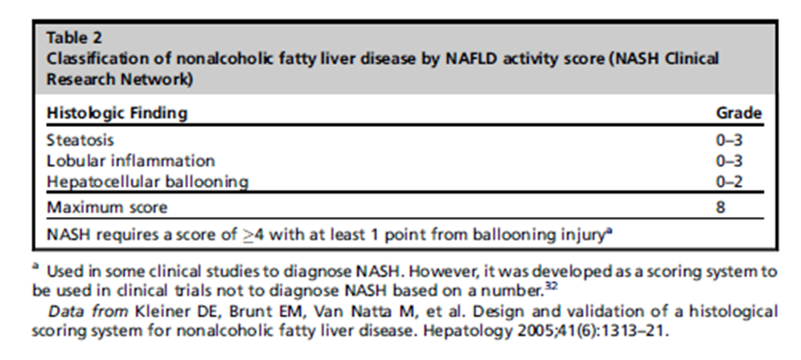
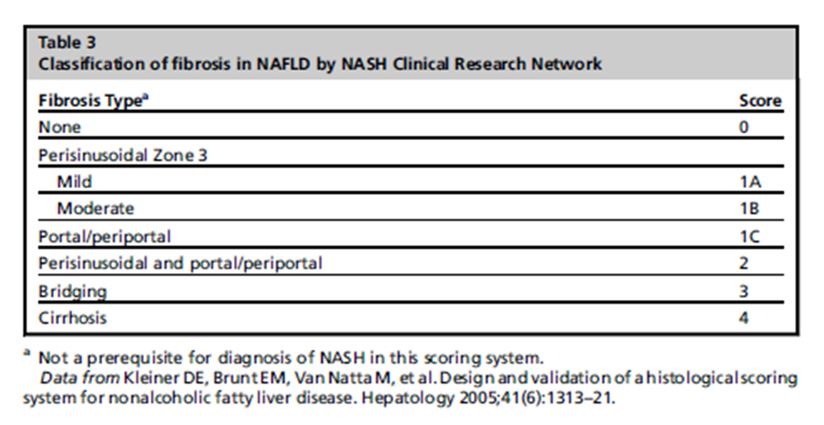
Outcomes in Clinical Trials
Resolution of NASH
CRN NAFLD activity score (NAS)
CRN Fibrosis Score
Earlier trials were oriented toward detecting a statistically significant change in NAS, but this outcome has not been shown to correlate with long term morbidity and mortality
Newer trials are longer and endpoint driven, with a primary outcome of interest as fibrosis, cirrhosis, or mortality and patients selected for fibrosis severity
Younossi ZM, Stepanova M, Rafiq N, et al. Pathologic criteria for nonalcoholic steatohepatitis: Interprotocol agreement and ability to predict liver‐related mortality. Hepatology. 2011;53:1874-1882.
Notes:
A separate system of scoring the features of nonalcoholic fatty liver disease (NAFLD) called the NAFLD Activity Score (NAS) was developed as a tool to measure changes in NAFLD during therapeutic trials. NAS was developed because the dichotomous assessment of NASH v no NASH was thought to fail to capture the value of lessened severity of NASH. However, recent studies have conclusively shown that NAS does not correlate to long term morbidity and mortality.
Moreover, some studies have used NAS ≥ 5 as a surrogate for a histological diagnosis of NASH, which the NAS was never designed to be used for and has been shown to poorly correlate to.
Brunt EM, Kleiner DE, Wilson LA, et al. Nonalcoholic fatty liver disease (NAFLD) activity score and the histopathologic diagnosis in NAFLD: distinct clinicopathologic meanings. Hepatology. 2011;53:810-820.

Slide 7
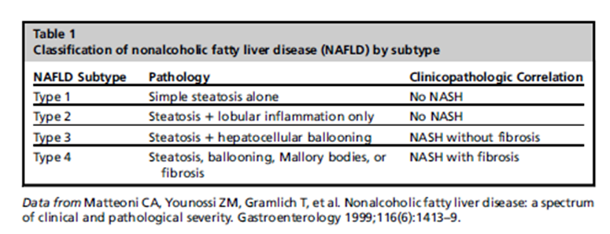
Clinical Controversy: Diagnosis of NASH
Different trials used different definitions of NASH to quantify treatment effects on NASH resolutions
Pivotal Younossi et al. (2011) study compared three different definitions of NASH and the study’s own proposed definition, among each other for correlation and also to clinical outcomes
a diagnosis of NASH by the original criteria for NAFLD subtypes by Matteoni et al., (presented below) [adjusted hazard ratio = 9.94 (95% confidence interval = 1.28-77.08)] demonstrated the best independent association with liver-related mortality.
the presence of advanced fibrosis is the only histologic lesion to be associated with liver-related mortality. Neither steatosis, inflammation, ballooning, nor Mallory hyaline was associated with liver-related mortality after adjusting for the presence of fibrosis.
More fundamental dilemma: What is NASH?
Are we creating a disease for the purpose of developing a treatment?
Assumes that risk stratification is best accomplished by a snapshot of histopathological presentation rather than another assessment, e.g. a multifactor disease-risk stratification model
Younossi ZM, Stepanova M, Rafiq N, et al. Pathologic criteria for nonalcoholic steatohepatitis: Interprotocol agreement and ability to predict liver‐related mortality. Hepatology. 2011;53:1874-1882.
Notes:
Some hepatologists go so far as to dismiss NASH as not a “real” disease

Slide 8
Fibrosis measures effectiveness in NASH
Fibrosis is the only histopathological finding consistently associated with mortality in numerous studies (mostly retrospective cohort), listed below
Furthermore, fibrosis is the scoring metric with the greatest inter-observer reliability
Diagnosis of NASH by original criteria had a greater HR than fibrosis– HR 9.9 (95% CI = 1.28-77.08) vs 5.6 (95% CI = 1.92-6.46) but a MUCH wider confidence interval in Younossi et al.
Clinical trials did not even necessarily diagnose NASH according to the original criteria
For these reasons, I chose to create a Markov model of NAFLD by modeling the progression of fibrosis through stages 0-1 and associating each stage with a probability of mortality and a probability of developing HCC
Dulai PS, Singh S, Patel J, et al. Increased risk of mortality by fibrosis stage in nonalcoholic fatty liver disease: Systematic review and meta‐analysis. Hepatology. 2017;65:1557-1565
Pagadala MR, MD, McCullough AJ, MD. The Relevance of Liver Histology to Predicting Clinically Meaningful Outcomes in Nonalcoholic Steatohepatitis. Clinics in Liver Disease. 2012;16:487-504
Ekstedt M, Hagström H, Nasr P, et al. Fibrosis stage is the strongest predictor for disease‐specific mortality in NAFLD after up to 33 years of follow‐up. Hepatology. 2015;61:1547-1554
Angulo P, Kleiner DE, Dam-Larsen S, Adams LA, Bjornsson ES, Charatcharoenwitthaya P, et al. Liver Fibrosis, but No Other Histologic Features, Is Associated With Long-term Outcomes of Patients With Nonalcoholic Fatty Liver Disease. Gastroenterology. 2015;149(2):389-97 e10.
Hagström H, Nasr P, Ekstedt M, et al. Fibrosis stage but not NASH predicts mortality and time to development of severe liver disease in biopsy-proven NAFLD. Journal of hepatology. 2017;67:1265-1273.
Notes:
It appears with disease progression over time, there is a decrease in in NAS simultaneously with a worsening of fibrosis, thereby decreasing the accuracy of diagnosing NASH based on NAS CRN score

Slide 9
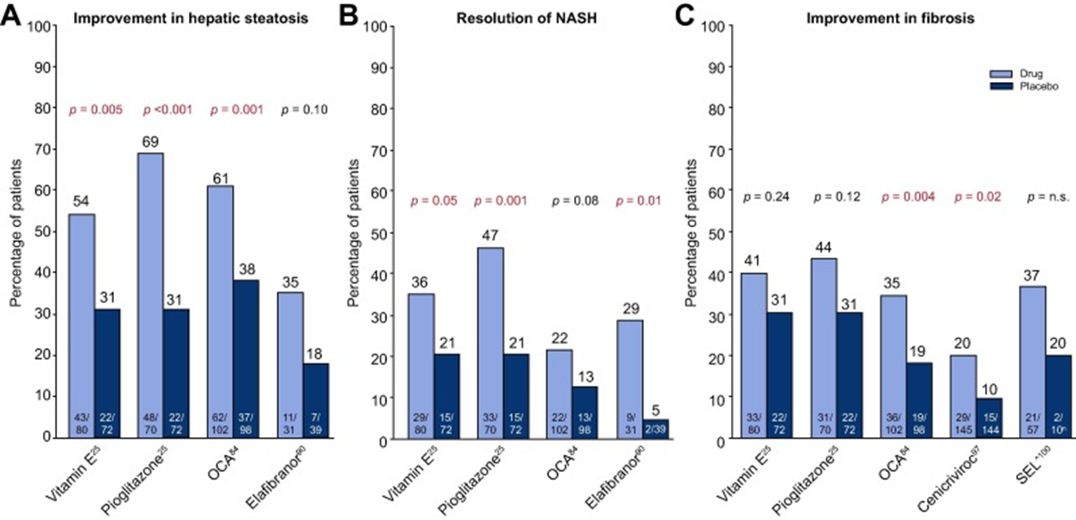
Comparison of Outcomes
Fig. 5 Improvement with pharmacologic agents. * (A) On hepatic steatosis (B) resolution of NASH and (C) Fibrosis. *Results are from separate studies and not a reflection of head to head direct comparison of listed agents on outcomes of interest. Trials for individual treatment agents employed different enrollment criteria and durations of therapy, and the primary endpoint definitions were not identical. ^SEL study compared SEL ± SIM to SIM alone, not placebo. Data here reflects arms with SEL compared to SIM arm alone. NASH, non-alcoholic steatohepatitis; n.s., not significant; OCA, obeticholic acid; SEL, selonsertib.
Konerman MA, Jones JC, Harrison SA. Pharmacotherapy for NASH: Current and emerging. Journal of Hepatology. 2018;68:362-375.
Notes:
Vitamin E, pioglitazone, and selonsertib have not been shown to affect fibrosis progression

Slide 10
Markov Pharmacoeconomic analysis
Markov modeling is a type of modeling used for cost-utility analysis
Uses a series of transition probabilities to simulate the disease progression of a cohort of patients over time, given their baseline disease distribution
A time horizon of interest must be specified
For clinicians, a lifetime time horizon is of particular interest in maximizing patients’ clinical outcomes
For payers, a 5- or 10-year time horizon may be of greater interest
Costs are assigned to each disease state and total costs of care are calculated
By measuring the life years of the control population and modifying transition probabilities to reflect treatment effects, we are able to calculate life-years gained, and therefore assess the cost per life year gained
Cost savings are calculated when the cost of the treatment is less than the costs saved by averting disease progression/death over a time horizon
Life years are adjusted for quality of life at advanced disease states using standard quality-adjustment coefficients (called utility values) from patient-reported survey data

Slide 11
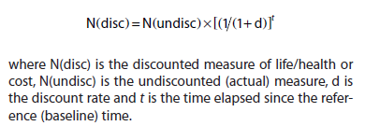
Characteristics of a Markov modeling
Individuals are placed in one of a set of mutually exclusive disease states
No memory – transition probability depends only on current, not past states
Markov assumption
Final absorbing event – death
Discounting is conventional
Between 3-5% annually
AMCP guidelines: 3%
Controversial
Ademi Z, Kim H, Zomer E, Reid CM, Hollingsworth B, Liew D. Overview of pharmacoeconomic modelling methods: Pharmacoeconomic methods. British Journal of Clinical Pharmacology. 2013;75:944-950.
Notes:
Some of these assumptions are not strictly followed in my model or in other published models
HCC is not a mutually exclusive disease state with NAFLD/Cirrhosis
Transition probability is likely affected by time spent in state and previous course of disease progression
Discounting
“Discounting is undertaken because life/health and money in the future is valued less than at the present
time (even after accounting for inflation). This reflects human nature’s preference for immediate gratification, and if not immediately, then as soon as possible”

Slide 12
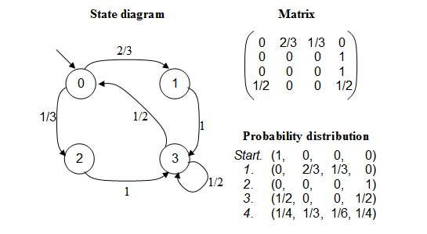
Markov Model: Structure
Notes:
State Diagram: visual illustration of which states transition between each other and what the probability of each transition is
Matrix: mathematical representation of which states transition between each other and what the probability of each transition is
Probability Distribution: result of matrix multiplication. The start distribution is multiplied by the transition probability matrix to yield matrix 1, the result of 1 cycle length.

Slide 13
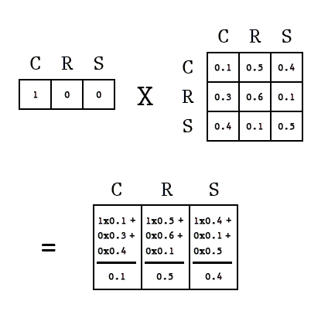
Markov Model: Calculation

Slide 14
A transition-state model for NAFLD
Outcome is overall mortality, not restricted to liver-related mortality
No distinction between NAFLD and NASH
F1-F2 are assumed to be NASH
F0 is both NAFLD and NASH w ballooning and inflammation
DISEASE STATE | DESCRIPTION
No NAFLD | no non-alcoholic fatty liver disease
NALFD F0 | nonalcoholic fatty liver disease without fibrosis (simple steatosis)
F1 | NAFLD with fibrosis stage 1
F2 | NAFLD with fibrosis stage 2
F3 | NAFLD with fibrosis stage 3 = “advanced fibrosis”
F4 | NAFLD with fibrosis stage 4 = compensated cirrhosis, also advanced fibrosis
DCC | decompensated cirrhosis
Liver Transplant | Liver transplant as the result of NASH-related cirrhosis
HCC | hepatocellular carcinoma as the result of NAFLD-related fibrosis
death
Notes:
DCC= body no longer able to meet the metabolic demands of the body, patients are symptomatic
Associated with hospitalizations, high cost, high morbidity and mortality (16% at 1 year)
Why fibrosis progression?
Explained on previous slides that fibrosis progression is the only histopathological feature associated with mortality
Why no distinction between NAFLD and NASH?
NASH diagnosis is questionable to me
Several recent studies have demonstrated histological progression in NAFLD patients without histological signs of NASH at baseline
Why death and not more specific liver related mortality?
Any cause-specific mortality (i.e., LRM) lacks true negative controls: i.e., deaths other than liver-related deaths did not mean the absence of life-threatening liver disease, so those who had been diagnosed with NASH but eventually did not die from liver-related causes were not genuine false positives.
CV mortality is the #1 cause of death in the NAFLD/NASH population

Slide 15
TRANSITION | PROBABILITY | SOURCES
NAFLD (ALL) → NASH F1 | 2.16% | High-end of estimate from Estes C, Razavi H, Loomba R, Younossi Z, Sanyal AJ. Modeling the epidemic of nonalcoholic fatty liver disease demonstrates an exponential increase in burden of disease. Hepatology. 2018;67:123-133.
NASH F1 → NAFLD F0 | 6.00% | Calibrated value from Younossi ZM, Henry L, Stepanova M, et al. The Economic and Clinical Burden of Non-Alcoholic Fatty Liver Disease in the United States. Journal of Hepatology. 2015;2016;64:S502-S503.
NASH F1 → NASH F2 | 11% | Adapted from Adams LA, Sanderson S, Lindor KD, Angulo P. The histological course of nonalcoholic fatty liver disease: a longitudinal study of 103 patients with sequential liver biopsies. Journal of Hepatology. 2005;42:132-138.
NASH F1 → HCC | 0.00093% | Estes C, Razavi H, Loomba R, Younossi Z, Sanyal AJ. Modeling the epidemic of nonalcoholic fatty liver disease demonstrates an exponential increase in burden of disease. Hepatology. 2018;67:123-133
NASH F2 → NASH F1 | 6.00% | Calibrated value from Younossi ZM, Henry L, Stepanova M, et al. The Economic and Clinical Burden of Non-Alcoholic Fatty Liver Disease in the United States. Journal of Hepatology. 2015;2016;64:S502-S503.
NASH F2 → NASH F3 | 11% | Adapted from Adams LA, Sanderson S, Lindor KD, Angulo P. The histological course of nonalcoholic fatty liver disease: a longitudinal study of 103 patients with sequential liver biopsies. Journal of Hepatology. 2005;42:132-138.
NASH F2 → HCC | 0.019% | Value from Estes C, Razavi H, Loomba R, Younossi Z, Sanyal AJ. Modeling the epidemic of nonalcoholic fatty liver disease demonstrates an exponential increase in burden of disease. Hepatology. 2018;67:123-133
NASH F3 → NASH F2 | 6.00% | Calibrated value from Younossi ZM, Henry L, Stepanova M, et al. The Economic and Clinical Burden of Non-Alcoholic Fatty Liver Disease in the United States. Journal of Hepatology. 2015;2016;64:S502-S503.
NASH F3 → NASH F4 | 7.2% | Value from Tapper EB, Sengupta N, Hunink MGM, Afdhal NH, Lai M. Cost-Effective Evaluation of Nonalcoholic Fatty Liver Disease With NAFLD Fibrosis Score and Vibration Controlled Transient Elastography. The American journal of gastroenterology. 2015;110:1298-1304.
NASH F3 → HCC | 0.038% | Value from Estes C, Razavi H, Loomba R, Younossi Z, Sanyal AJ. Modeling the epidemic of nonalcoholic fatty liver disease demonstrates an exponential increase in burden of disease. Hepatology. 2018;67:123-133
NASH F4 → NASH F3 | 6.00% | Calibrated value from Younossi ZM, Henry L, Stepanova M, et al. The Economic and Clinical Burden of Non-Alcoholic Fatty Liver Disease in the United States. Journal of Hepatology. 2015;2016;64:S502-S503.
NASH F4 → DCC | 11% | Based on Fleming KM, Aithal G, Card T, et al. The rate of decompensation and clinical progression of disease in people with cirrhosis: a cohort study. Alimentary pharmacology & therapeutics 2010;32:1343-1350.
NASH F4 → HCC | 2.6% | Value from Tapper EB, Sengupta N, Hunink MGM, Afdhal NH, Lai M. Cost-Effective Evaluation of Nonalcoholic Fatty Liver Disease With NAFLD Fibrosis Score and Vibration Controlled Transient Elastography. The American journal of gastroenterology. 2015;110:1298-1304.
DCC → HCC | 2.6% | Value from Tapper EB, Sengupta N, Hunink MGM, Afdhal NH, Lai M. Cost-Effective Evaluation of Nonalcoholic Fatty Liver Disease With NAFLD Fibrosis Score and Vibration Controlled Transient Elastography. The American journal of gastroenterology. 2015;110:1298-1304.
DCC → LT | 2.8% | Calibrated value from Younossi ZM, Henry L, Stepanova M, et al. The Economic and Clinical Burden of Non-Alcoholic Fatty Liver Disease in the United States. Journal of Hepatology. 2015;2016;64:S502-S503.
HCC → LT | 3.06% | Calibrated value from Younossi ZM, Henry L, Stepanova M, et al. The Economic and Clinical Burden of Non-Alcoholic Fatty Liver Disease in the United States. Journal of Hepatology. 2015;2016;64:S502-S503.
Notes:
Sources shown are the PE models that used the same input, not the original studies of the natural history of the disease which reported the probabilities

Slide 16
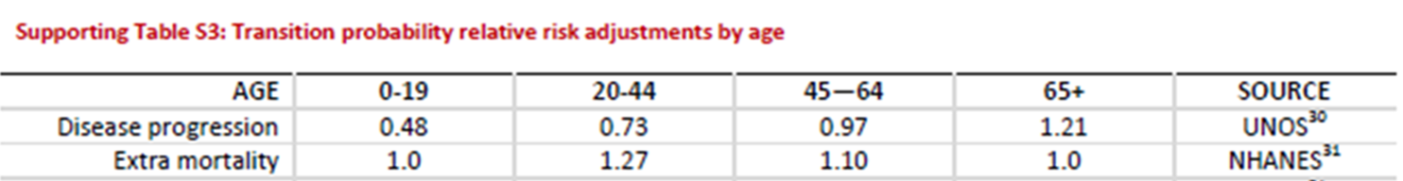
Inputs: Age-related Risk Adjustments
Transition probability is adjusted for age by multiplication of a age-related relative risk
Relative risks applied were consistent with other PE models
Assumption: Relative risk of disease regression (e.g. F1 → F0) was assumed to be mathematical inverse of the relative risk of disease progression
Age-related relative risk adjustments were adapted from the supplement of Younossi ZM, Henry L, Stepanova M, et al. The Economic and Clinical Burden of Non-Alcoholic Fatty Liver Disease in the United States. Journal of Hepatology. 2015;2016;64:S502-S503

Slide 17
Treatments of interest
Bariatric surgery
5-year retrospective cohort analysis showed profound reduction in fibrosis scores in patients with NAFLD/NASH
Furthermore, the biggest driver of mortality in the NAFLD population isn’t even liver disease, but CV disease, which bariatric surgery is known to modify
Future project is to create a multi-disease state model (integrating CV disease progression and diabetes disease progression) for the effect of bariatric surgery in a NAFLD population
One time cost of ~ $44,956
Per year medical costs go down after first year
Obetacholic Acid
RCT demonstrated effect on fibrosis regression, 72 month follow up
~$90,000/year, currently approved for primary biliary cholangitis
CVC – future direction
Similar size of effect (RR is 2.2 rather than OCA’s 2.0) on fibrosis regression
Not currently on the market – no price, longer road to approval

Slide 18
Outcomes of treatments
Treatment | Improvement in Fibrosis* | Distribution of effect by stage | Distribution of effect over time | Prevention of worsening of Fibrosis
Obeticholic acid [1] | RR, 2.0 (1.2-3.4, p=0.004) | Only studied in NASH without cirrhosis (F4) Not reported whether higher stages experienced greater or less effect | Trial duration = 72 weeks Assume treatment effects occur over 5 years Conservatively assume that treatment effect persists over 5 years – do not assume treatment effect either tapers off or increases | Not reported! Assume no effect
Bariatric surgery [2] | OR 18.90 (2.10-170.39) – univariate analysis Adjusted OR 4.10 (0.32-52.12) Odds ratio < 10% Assume Odds ratio = RR | Patients in higher Fibrosis stage more likely to achieve fibrosis regression (mean stage experiencing regression = 2.5, v no regression mean stage = 1.9, p = 0.02) TREAT ONLY for F2 and F3 IN MODEL | Mean follow up = 4.5 years, Assume treatment effects were relatively linear between years 1-4 Assume treatment effect tapered off around years 4-5 | Not reported! Assume no effect
Neuschwander-Tetri BA, Loomba R, Sanyal AJ, Lavine JE, Van Natta ML, Abdelmalek MF, et al. Farnesoid X nuclear receptor ligand obeticholic acid for non-cirrhotic, non-alcoholic steatohepatitis (FLINT): a multicentre, randomised, placebo-controlled trial. Lancet. 2015;385(9972):956-65.
Glass LM, Dickson RC, Anderson JC, et al. Total Body Weight Loss of ≥10 % Is Associated with Improved Hepatic Fibrosis in Patients with Nonalcoholic Steatohepatitis. Digestive Diseases and Sciences. 2015;60:1024-1030.
Notes:
Improvement in fibrosis is defined as regression of ≥1 stage of fibrosis
Also unknown how many patient’s regression greater than 1 stage vs. how many regressed 1 stage
Model assumes that patients only experienced 1 stage reduction in score per cycle length (1 year)
Fantastic resource where I learned about probabilities, rate conversions, and RR vs OR: thank you Ms. Gidwani!
https://www.hsrd.research.va.gov/for_researchers/cyber_seminars/archives/2401-notes.pdf
Her lecture: https://www.hsrd.research.va.gov/for_researchers/cyber_seminars/archives/video_archive.cfm?SessionID=2401
Bariatric surgery studies were not powered to detect difference in fibrosis scores

Slide 19
Inputs: Treatment probabilities
Only treated F2 and F3 because these were the patients studied in the OCA trial
Only treated for 5 years
Obetacholic Acid:
derived from clinical trial data
Follow up period: 1 year
Bariatric surgery:
derived from a long term retrospective cohort analysis
Mean follow up time = 5.4 years
Included all patients with NASH
TRANSITION PROBABILITY | Control | OCA | Bariatric surgery
F2 → F1 | 6.0% | Y1: 6.00% X RR 2.0 = 12% Y2: 6.00% X RR 2.0 = 12% Y3: 6.00% X RR 2.0 = 12% Y4: 6.00% X RR 2.0 = 12% Y5: 6.00% X RR 2.0 = 12% | Y1: 6.00% X RR 2.0 = 12% Y2: 6.00% x RR 3.0 =18% Y3: 6.00% x RR 3.5 = 21% Y4: 6.00% x RR 4.0 = 24% Y5: 6.00% x RR 4.1 = 24.6%
F2 → F3 | 11.0% | 11% **conservatively assume no effect for now | 11% **conservatively assume no effect for now
F3 → F2 | 6.0% | Y1: 6.00% X RR 2.0 = 12% Y2: 6.00% X RR 2.0 = 12% Y3: 6.00% X RR 2.0 = 12% Y4: 6.00% X RR 2.0 = 12% Y5: 6.00% X RR 2.0 = 12% | Y1: 6.00% X RR 2.0 = 12% Y2: 6.00% x RR 3.0 =18% Y3: 6.00% x RR 3.5 = 21% Y4: 6.00% x RR 4.0 = 24% Y5: 6.00% x RR 4.1 = 24.6%
F3 → F4 | 7.2% | 7.2% **conservatively assume no effect for now | 7.2% **conservatively assume no effect for now
F4 → F3 | 6.0% | 6.0% (not treated) | 6.0% (not treated)
Notes:
Treatment effects
Applied a flat relative risk of 2.0 for regression for OCA
Assumed a linear relationship between time and fibrosis regression for bariatric surgery, tapering off at year 4
Probably a more mathematically rigorous way to distribute treatment effect for bariatric surgery
Fundamental limitation
Comparing outcomes from studies with different designs, with very different follow-up time frames
However, the profound effect found in the retrospective cohort study suggests that longer time frames are needed to appreciate treatment effects on fibrosis regression (this is also the reason that the ongoing Phase 3 clinical trials all have 4+ year of endpoint-driven time frames)
Can I somehow massage the numbers and fairly present the results by qualifying in my discussion that longer clinical trials will be better equipped to assess the pharmacoeconomic implications of treatments?
Anyway I want to emphasize the take-away from my paper to be there is a model for the pharmacoeconomic implications of fibrosis regression as the most clinically meaningful outcome, and that ongoing clinical trials should fully quantify the size, distribution, and clinical characteristics associated with fibrosis regression, not necessarily that these particular outcomes should guide policy making for payers
Creating a web-app from the model would enable critics and payers to impute their own values and assumptions and model their own population

Slide 20
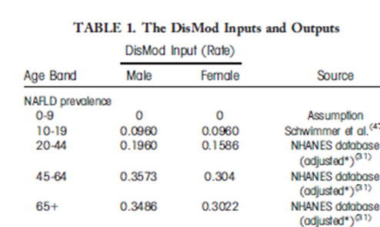
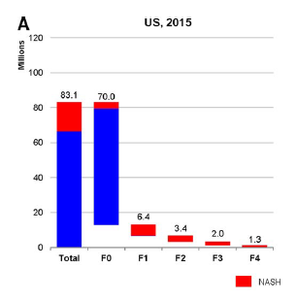
Inputs: Prevalence
Derived from other PE models which sourced epidemiological studies
Inputs for age-NAFLD prevalence were adapted from Younossi et al. 2015 “The Economic and Clinical Burden of Non-Alcoholic Fatty Liver Disease in the United States” values were averaged to get overall rate without gender
Averaged inputs
Age 20-24: 0.0960
Age 25-44: 0.1773
Age 45-64: 0.33065
Age 65 +: 0.3254
Distribution of NAFLD by fibrosis stage was derived from Estes et al., 2018 (above), which calculated cases in millions. The following percentages were inputted based on these results: Stage 0 – 84.2%, Stage 1 – 7.7%, Stage 2 – 4.1%, Stage 3 – 2.4%, Stage 4 – 1.5%
Notes:
Age cohorts
Presently, my model (unlike Younossi’s) does not separate patients by gender (would double the amount of computation)
Patients are placed in 5-year age bands (e.g., 20-24, 25-29, etc) and aged together in 1 year cycles
Modelled using US population distribution by age (more baby boomers and millennials than Gen Y’s)
But if I want to compare treatment cost-effects for different age groups, should I match each of the age bands for fairer comparison? i.e. have a thousand patients in each age bracket?

Slide 21
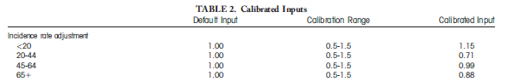
Inputs: Prevalence cont
Decompensated Cirrhosis Prevalence
Dilemma: Input from Zhang et al., included both decompensated and compensated cirrhosis
For now assumed that total cirrhosis reported in Zhang = DCC at 0.0019 (0.0018-0.0020) out of general population
Unable to find better statistics in the literature for DCC prevalence specific to NAFLD
Age-by-disease stage distribution – need advisement
Used inputs calibrated by Younossi et al (shown below), as opposed to sourced from epidemiological data
Probably should not have applied this as a cofactor to the prevalences shown on the previous page to derive age-specific prevalences of specific stages of fibrosis since this was a incidence rate adjustment, not a prevalence proportion adjustment
May need to calibrate my own inputs
Zhang E, Wartelle-Bladou C, Lepanto L, Lachaine J, Cloutier G, Tang A. Cost-utility analysis of nonalcoholic steatohepatitis screening. European radiology. 2015;25:3282-3294.
Younossi ZM, Henry L, Stepanova M, et al. The Economic and Clinical Burden of Non-Alcoholic Fatty Liver Disease in the United States. Journal of Hepatology. 2015;2016;64:S502-S503
Notes:
DCC input
Simple subtraction of Input from Zhang (F4 + DCC) from Input from Estes et al (F4) should yield DCC rate, but in fact yields input a negative number
Problem with hobbling together many studies with different methodologies
Unable to find a prevalence for decompensated cirrhosis, specifically due to NAFLD either out of the whole NAFLD population or the general population
Age-by-stage distribution
Unable to find data about this in the literature
Likely that this doesn’t exist, since Younossi et al., calibrated their inputs
Problem
Total NAFLD prevalence input = proportion
“Incidence” Rate adjustment cannot be applied to a prevalence
How can I convert incidence rate adjustment to a prevalence adjustment ratio???
Alternatively, I will have to calibrate my own inputs
More fundamental
the idea is that age influences progression to later disease stages not just the gross histological severity of the disease
Also, older individuals would be less likely to present at severe stages of disease because they are more likely to die of other causes
Thus it makes sense to introduce an age-based cofactor, but considering these are calibrated (i.e. made up) inputs anyway we will have to see what they are calibrated to?
If I do not apply an age-cofactor to prevalence, then I will be implying that the same proportion of NAFLD patients will have stage 4 cirrhosis no matter whether they are 20 or 40 (feels wrong)

Slide 22
Inputs: Prevalence cont
HCC prevalence
Used for value used by Younossi et al 2015, which sites two epidemiological studies
In NASH: 0.529%
Added F1 + F2 + F3 + F4 inputs to yield total number of patients in NASH
Multiplied total NASH patients by proportion of 0.00529 and age adjustment to yield input
Liver transplant
Previous analysis of data from the Scientific Registry of Transplant Recipients (SRTR) reported proportion of patients with cirrhotic-stage NASH was 3.5% in 2005
Added F4 + DCC to get total cirrhosis cohort
Multiplied total cirrhosis patients by reported proportion of 0.035 and age adjustment to yield input
Younossi ZM, Henry L, Stepanova M, et al. The Economic and Clinical Burden of Non-Alcoholic Fatty Liver Disease in the United States. Journal of Hepatology. 2015;2016;64:S502-S503
Charlton MR, Burns JM, Pedersen RA, Watt KD, Heimbach JK, Dierkhising RA. Frequency and Outcomes of Liver Transplantation for Nonalcoholic Steatohepatitis in the United States. Gastroenterology. 2011;141:1249-1253.
Angulo P. Nonalcoholic fatty liver disease and liver transplantation. Liver Transpl 2006;12:523–534
Notes:
Younossi et al 2015 cites:
Younossi ZM, Koenig AB, Abdelatif D, Fazel Y, Henry L, Wymer M. Global epidemiology of non-alcoholic fatty liver disease-meta-analytic assessment of prevalence, incidence and outcomes. Hepatology 2016;64:73-84.
Starley BQ, Calcagno CJ, Harrison SA. Nonalcoholic fatty liver disease and hepatocellular carcinoma: a weighty connection. HEPATOLOGY 2010;51:1820-1832.

Slide 23
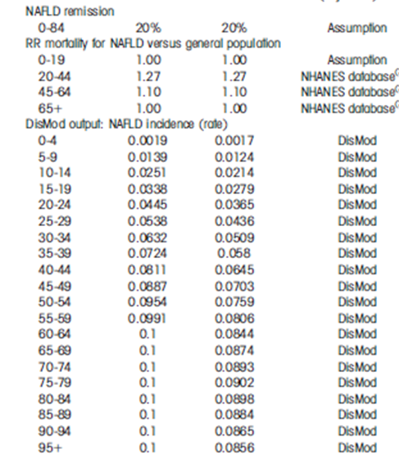
Inputs: Incidence of new NAFLD
Derived the results of Younossi et al., 2015 (shown to the left)
Gender-specific incidences were averaged to yield overall rate without gender-specificity
Incidences (rates) were converted to annual transition probabilities for integration into transition-state model (shown next slide)
Rate of remission to disease free state was matched to Younossi et al., 2015
Input from Younossi was an assumption
Calibrated input = 19%, calibration range 16-24%
Rate was likewise converted to annual probability
Probability = 1 – e^(-0.19 x 1 year) = 0.17304
Varied according to age-specific regression relative risk (another assumption)
Younossi ZM, Henry L, Stepanova M, et al. The Economic and Clinical Burden of Non-Alcoholic Fatty Liver Disease in the United States. Journal of Hepatology. 2015;2016;64:S502-S503
Notes:
Is it kosher to borrow another model’s output for your input? Probably questionable but how else to derive a NAFLD rate-by-age distribution?

Slide 24
Calculation of Annual probability of NAFLD from Incidence
Age bracket | Non-gender average rate | Calculation | Annual Transition Probability
20-24 | 0.0405 | Probability = 1 – e^(-0.0405 x 1 year) | 0.0396
25-29 | 0.0487 | Probability = 1 – e^(-0.0487 x 1 year) | 0.04753
30-34 | 0.0571 | Probability = 1 – e^(-0.0571 x 1 year) | 0.0555
35-39 | 0.0652 | Probability = 1 – e^(-0.0652 x 1 year) | 0.0631
40-44 | 0.0728 | Probability = 1 – e^(-0.0728 x 1 year) | 0.0702
45-49 | 0.0792 | Probability = 1 – e^(-0.0792 x 1 year) | 0.0761
50-54 | 0.08535 | Probability = 1 – e^(-0.0854 x 1 year) | 0.0818
55-59 | 0.0899 | Probability = 1 – e^(-0.0899 x 1 year) | 0.0856
60-64 | 0.0922 | Probability = 1 – e^(-0.0922 x 1 year) | 0.0881
65-69 | 0.0937 | Probability = 1 – e^(-0.0937 x 1 year) | 0.0894
70-74 | 0.09465 | Probability = 1 – e^(-0.0947 x 1 year) | 0.0904
75-79 | 0.0951 | Probability = 1 – e^(-0.0951 x 1 year) | 0.0907
Notes:
Fantastic resource where I learned about probabilities, rate conversions, and RR vs OR:
https://www.hsrd.research.va.gov/for_researchers/cyber_seminars/archives/2401-notes.pdf

Slide 25
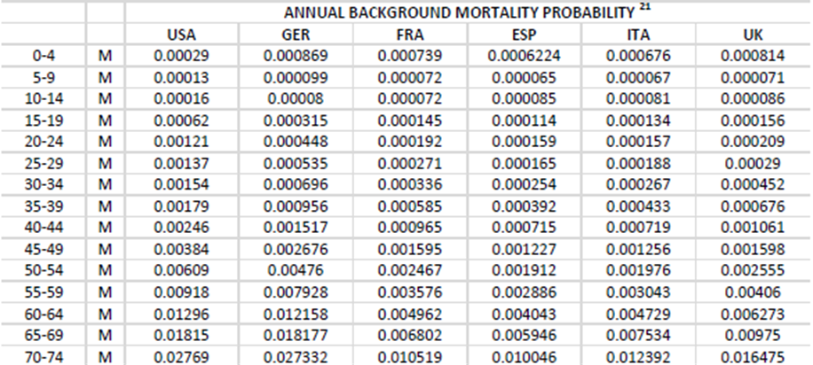
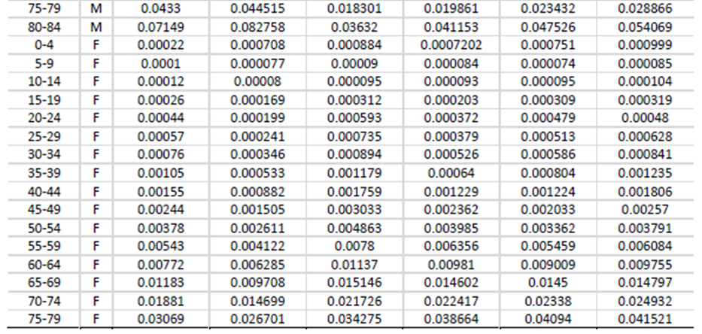
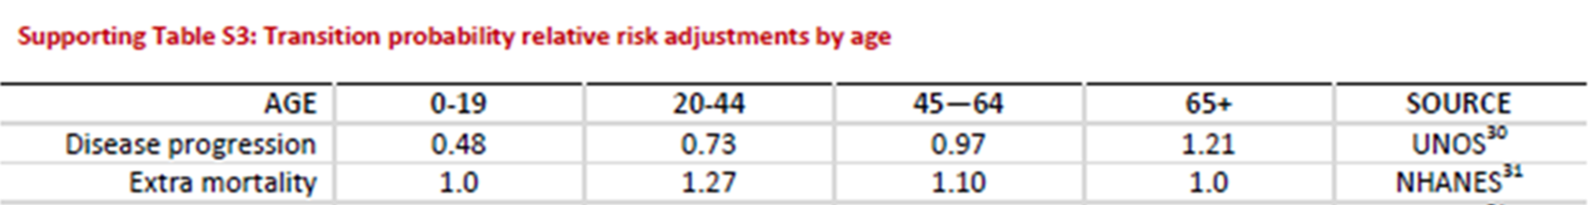
Inputs: Mortality
Averaged gender-specific mortalities used as inputs in model by Younossi et al to yield background mortality by age (shown left)
Applied relative risks of mortality associated with each fibrosis stage (next slide
Applied age-mortality relative risks (shown below)
Assigned flat risks (not age weighted) of death to high mortality states: DCC, HCC, and liver transplant
DCC: 16% (15%-38%)
Tapper EB, Sengupta N, Hunink MGM, Afdhal NH, Lai M. Cost-Effective Evaluation of Nonalcoholic Fatty Liver Disease With NAFLD Fibrosis Score and Vibration Controlled Transient Elastography. The American journal of gastroenterology. 2015;110:1298-1304.
HCC: 62.24%
Younossi ZM, Henry L, Stepanova M, et al. The Economic and Clinical Burden of Non-Alcoholic Fatty Liver Disease in the United States. Journal of Hepatology. 2015;2016;64:S502-S503.
Liver transplant: 7%
Tapper EB, Sengupta N, Hunink MGM, Afdhal NH, Lai M. Cost-Effective Evaluation of Nonalcoholic Fatty Liver Disease With NAFLD Fibrosis Score and Vibration Controlled Transient Elastography. The American journal of gastroenterology. 2015;110:1298-1304
Younossi ZM, Henry L, Stepanova M, et al. The Economic and Clinical Burden of Non-Alcoholic Fatty Liver Disease in the United States. Journal of Hepatology. 2015;2016;64:S502-S503
Notes:
Limitation
Year 1 mortality with LT is 14%, Year 2 mortality with LT is 7%
Somehow I did not realize that I could easily assign these two different mortality rates by designating Year 1 LT as a separate disease state (I was hung up on the fact that Markov is memoryless and year 1 cannot be distinguished from patients who have been in this state for greater than a year)
→ Addition of Year 1 LT as separate disease is in progress, should improve accuracy of model, also very important since LT is huge sequelae, and one f great interest in this PE analysis

Slide 26
Relative risk of mortality by fibrosis stage
Derived from results of study by Dulai et al., 2017
Reported as “mortality rate ratios” → used raw probabilities as reported in results to calculate my own relative risks
Step 1: Convert Raw Rates to probabilities
Stage 0 Rate = 15.2 per 1,000 patient years of follow-up = 0.0152 per patient year follow up
Probability = 1 – e^ (-0.0152 x 1 year) = 0.01508
Probability = 1.508% in stage 0
Compare to general background mortality for a 50 year old
Stage 1 Rate = 17.1 per 1,000 patient years of follow up = 0.0171 per patient year follow up
Probability = 1-e^(-0.0171 x 1 year) = 0.01695
Probability = 1.695% in stage 1
Stage 2 Rate = 27.9 per 1,000 patient years of follow up = 0.0279 per patient year follow up
Probability = 1 – e^(-0.0279 x 1 year) = 0.02751
Probability = 2.751% in stage 2
Stage 3 Rate = 36.0
Probability = 1-e^(-0.0360 x 1 year) = 0.03536
Probability = 3.536% in stage 3
Stage 4 Rate = 45.8
Probability = 1-e^(0.0458 x 1 year) = 0.04477
Probability = 4.477% in stage 4
Step 2: Calculate Relative Risks to apply to modify mortality probabilities
RR of Stage 1 = 1.124
RR = Probability in F1 / Probability in F0
RR = 0.01695 / 0.01508 = 1.124
RR of Stage 2 = 1.802
RR = Probability in F2 / Probability in F0
RR = 0.02751 / 0.01508 = 1.802
RR of Stage 3 = 2.345
RR = Probability in F3 / Probability in F0
RR = 0.03536 / 0.01508 = 2.345
RR of Stage 4 = 2.969
RR = 0.04477 / 0.01508 = 2.969
Dulai PS, Singh S, Patel J, et al. Increased risk of mortality by fibrosis stage in nonalcoholic fatty liver disease: Systematic review and meta‐analysis. Hepatology. 2017;65:1557-1565.
Notes:
Fantastic resource where I learned about probabilities, rate conversions, and RR vs OR:
https://www.hsrd.research.va.gov/for_researchers/cyber_seminars/archives/2401-notes.pdf

Slide 27
Inputs: PPPY Disease State Costs
Derived from 2 large, retrospective cohort studies from a massive administrative claims database
large commercial insurer database affiliated with OptumInsight ~ 50 million people
Costs of F0-F4 had to be inferred based on average NAFLD costs
Probably a more mathematically sophisticated way to do this
Final input was adjusted for medical inflation using online calculator, reported in 2017 dollar
https://halfhill.com/inflation_js.html
 | PPPY COSTS | YEAR 1 COSTS
NO NAFLD | $2,509 [1]
NAFLD F0 | $3,875 [2] | $8,519 [1]
F1 | $3,925 [2]
F2 | $4,000 [2]
F3 | $4,500 [2]
F4 | $20,712 [3]
DCC | $51,184 [3]
HCC | $70,930 [3]
LT | $67,168 [3] | $233,738 [3]
DEATH |  | $62,317 [4]
Allen AM, Van Houten HK, Sangaralingham LR, Talwalkar JA, McCoy RG. Healthcare Cost and Utilization in Nonalcoholic Fatty Liver Disease: Real-World Data from a Large US Claims Database. Hepatology (Baltimore, Md.). 2018.
Roughly guesstimated using results of Allen et al., total NAFLD population PPPY cost (method shown on next slide)
McAdam-Marx C, McGarry LJ, Hane CA, Biskupiak J, Deniz B, Brixner DI. All-cause and incremental per patient per year cost associated with chronic hepatitis C virus and associated liver complications in the United States: a managed care perspective. Journal of managed care pharmacy : JMCP. 2011;17:531
Tapper EB, Sengupta N, Hunink MGM, Afdhal NH, Lai M. Cost-Effective Evaluation of Nonalcoholic Fatty Liver Disease With NAFLD Fibrosis Score and Vibration Controlled Transient Elastography. The American journal of gastroenterology. 2015;110:1298-1304
Notes:
Medical Inflation Adjustment
Was in a rush to get costing done within my 6-week rotation and didn’t have time to calculate these by hand, will probably need to for final inputs

Slide 28
Inputs: PPPY Disease State Costs cont
There exist no studies of costs associated with specific fibrosis stages
I know because Gilead told me they were looking for a way to do it too!
Estimation of costs for each fibrosis stage
NAFLD average for all states: $4,136
Per results of Allen et al., 2018
Guessed costs associated with fibrosis stage and calculated a weighted average (based on % in that stage) to match the study result
Average = $3,875 (0.843) + $3,925 (0.077) + $4,000 (0.041) + $4,500 (0.024) + $20,712 (0.015) = $4,151 – good enough
Again, probably a more mathematically rigorous way to distribute costs would be beneficial (or expert opinion)
Limitations
compensated cirrhosis (F4), decompensated cirrhosis, HCC, and liver transplant PPPY costs were derived from a cohort analysis of Hep C patients
But, other PE models of NAFLD/NASH also used inputs from Hep C studies!
Costs are flat, not weighted by age –would greatly increase computation to calculate age-weighted costs in Excel

Slide 29
Inputs: Treatment Costs
Added in addition to background disease state cost
OCA costs and effects were only assessed for 5 years of treatment
Bariatric surgery actually results in cost savings after the first year, therefore year 1 costs were only added
Did not mark down annual PPPY costs to account for treatment effects on resolving diabetes and CV disease in treated patients, as this would be a complicated calculation
Drug & dose | Price ($) per dose | Resource | Year 1 Annualized $ | Year 2-5 PPPY $
Bariatric Surgery | $44,050 | Per Makary et al, 2010 | $44,956 | $0
Obeticholic Acid 5 mg/10 mg | $245.10/dose | LexiComp | X 365 days = $89,461.50 | $89,461.50
Obeticholic Acid 25 mg | Not priced, will index to available 10 mg dose |  | X 365 days = $89,461.50 | $89,461.50
Cenicriviroc | Not available/no price
Makary MA, Clark JM, Shore AD, et al. Medication Utilization and Annual Health Care Costs in Patients With Type 2 Diabetes Mellitus Before and After Bariatric Surgery. Archives of Surgery. 2010;145:726-731

Slide 30
Inputs: Utilities
Final inputs | Quality Weight
No NAFLD | 1
NAFLD F0 | 1
F1 | 0.95
F2 | 0.95
F3 | 0.92
F4 | 0.78
DCC | 0.6
HCC | 0.65
LT | 0.75
death
Simply a cofactor applied to each life year in a particular disease state to calculate quality adjusted life years (QALY)
Assigned either by “expert opinion” or derived from patient questionnaires
Generally adapted values from Tapper et al., which were derived from patients (preferred)
Study name | Tapper et al., 2015 | Younossi et al., 2016 | Zhang E et al., 2015. | Mahady et al 2012
Well | 1 |  | 1 | 1
NAFLD | 1 | 0.73 | 1.0 (0.86-1) Assumption
NASH F1 | 0.95 | 0.73 | 0.84
NASH F2 | 0.95 | 0.73 | 0.84
NASH F3 | 0.92 | 0.73 | 0.84 | 0.92
NASH F4 | 0.78 | 0.71 | 0.80 | 0.82
DCC | 0.6 | 0.57 | 0.60 | 0.60
HCC | 0.65 | 0.49 | 0.73 | 0.73
LT | 0.69 (first year) 0.79 (year 2+) | 0.567 | 0.69 (first year) 0.80 (year 2+) | 0.69 (first year)
Notes:
Tapper et al: Triangular distributions were employed for utilities with multiple estimates in the literature; otherwise for values without published ranges, a distribution of + 20% was assumed. Only patient-derived state-utility estimates were only included, excluding estimates from expert opinion

Slide 31
Preliminary Results
Treatment with bariatric surgery resulted in an average 4.59 QALY gained per patient treated. Bariatric surgery is cost-effective at a willingness-to-pay threshold of <$50,000 per QALY with a computed ICER of $4,269 per QALY.
Treatment of patients <40 years of age resulted in lifetime cost savings.
Treatment with obeticholic acid was associated with 3.55 QALY gained per patient treated and was not cost effective at a willingness-to-pay threshold of <$50,000 per QALY with an ICER of $140,486 per QALY.
No model calibration
No sensitivity analysis!
Minor editing needed as well → waiting to implement these all at once
Need to add Liver Transplant Year 1 as separate disease state to assign its own mortality rate and quality adjustment

Slide 32
Ongoing work, Assumptions/inputs
Modified transition state probability model for treatments
Studies did not report effects of treatments on percent of patients who did not progress 1 fibrosis stage, only the patients who regressed ≥1 stage
Studies did not describe distribution of effect, i.e. how many patients regressed 1 stage, 2 stages, and 3 stages
Could probably email the study authors for OCA information (since it would strengthen the case for their treatment) but don’t know how to make fair assumptions about this for bariatric surgery
Treatment duration and target
Currently 5 years, only those patients in F1 and F2
Transition state probabilities return to baseline after 5 year treatment window
Costing
Costs for advanced liver disease derive from retrospective cohort studies of Hep C patients in large administrative claims databases
Also, have not implemented the fact that total PPPY costs decrease with bariatric surgery
Discounting?
Notes:
Discounting
In pharmacoeconomic modelling, all measures of health and costs are referenced to the baseline time, and future measures of life/health and costs are discounted [14] by convention. Discounting is undertaken because life/health
and money in the future is valued less than at the present time (even after accounting for inflation). This reflects human nature’s preference for immediate gratification, and if not immediately, then as soon as possible.

Slide 33
Ongoing work, methodological questions
Model calibration to prevalence targets – need help
Method of sensitivity analysis: step-wise one-way in Excel or Monte Carlo
Significant benefit vs time-investment? Pretty much necessary?
Also, still working out the how – software suite, method
Multi-disease model for bariatric surgery – known CV benefit
Dr. Schentag very eager to model treatment effects of multiple disease states
How to best approach? Integrated into fibrosis progression model or separate Markov model with population overlaid?
Markov model assumes mutually exclusive states
Published guidelines
Haddix AC. Prevention Effectiveness: A Guide to Decision Analysis and Economic Evaluation. New York: Oxford University Press; 1996.
Sanders GD, Neumann PJ, Basu A, et al. Recommendations for Conduct, Methodological Practices, and Reporting of Cost-effectiveness Analyses: Second Panel on Cost-Effectiveness in Health and Medicine. JAMA. 2016;316:1093-1103
Siegel JE, Weinstein MC, Russell LB, Gold MR. Recommendations for Reporting Cost-effectiveness Analyses. JAMA. 1996;276:1339-1341.
Notes:
Method of sensitivity analysis
Monte Carlo is very popular and trendy with the data scientists these days
Probabilistic sensitivity analysis is the standard of NICE in UK
On the other hand, the 2016 study by Younossi et al., “The value of cure associated with treating treatment-naïve chronic hepatitis C genotype 1: Are the new all-oral regimens good value to society?” only used a one-day deterministic sensitivity analysis, was published in Liver International
One-way deterministic sensitivity analyses explored a range of values for parameters previously determined to be key drivers of the model, Sustained viral response rates were varied by ±10% from the base case and drug acquisition costs were varied by ±20% from the base case to assess the impact of these parameters on the value of cure results.

Slide 34
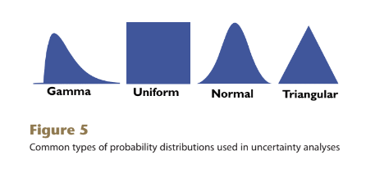
Uncertainty analyses of Markov Modeling
Traditional: Deterministic
Step-wise, univariate or multivariate
The use of this type of sensitivity analysis is limited, as it does not reveal the likelihood of the occurrence of each scenario.
Modern: Monte Carlo stochastic simulation/probabilistic sensitivity analysis
A method of undertaking multiple simulations of a model, each time taking samples from specified uncertainty ranges of the model’s inputs (as opposed to point estimates)
Probability distributions describe the range of possible values for a parameter as well as the probability of each value occurring (Figure 5)
Input distributions
Generates multiple outputs, from which probability distributions can also be derived.
Output distributions.
Ademi Z, Kim H, Zomer E, Reid CM, Hollingsworth B, Liew D. Overview of pharmacoeconomic modelling methods: Pharmacoeconomic methods. British Journal of Clinical Pharmacology. 2013;75:944-950.
Notes:
PSA has become standard, for example, NICE in the UK requires manufacturers to conduct probabilistic sensivity analysis in their modelling.
By convention, 10,000 iterations (samples) are often undertaken

Slide 35
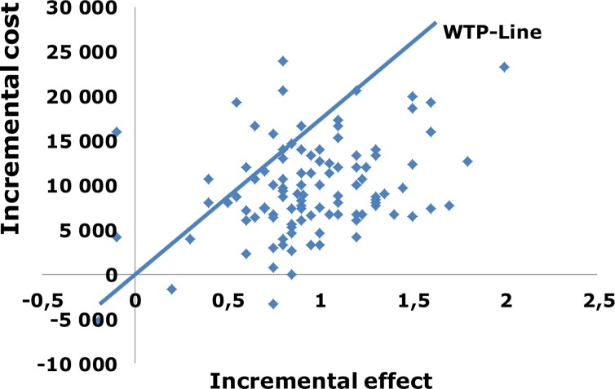
Probabilistic sensitivity analysis
Output of a PSA is shown below
Adalsteinsson E, Toumi M. Benefits of probabilistic sensitivity analysis - a review of NICE decisions. Journal of market access & health policy. 2013;1:21240.

Slide 36
Markov Chains in Excel
User friendly (for a newb) to perform initial calculations
Good for those with no training in data science or programming (me!)
Easy for lay people to modify and use
Tedious, time consuming calculations
Even more time consuming to edit the model
adding transition states and probabilities is difficult because every probability matrix has to be updated
for this reason, I’m waiting to compile all the necessary modifications and implement them in together at once
Unable to do Monte Carlo microsimulations without an add-on
Risk AMP is an add on that confers ability to run Monte Carlo simulations in Excel - $130
Python is optimized for Monte Carlo simulations, large computations, and even web-app development
Notes:
Risk AMP keeps me in Excel which is super tedious
Python is optimal but has a learning curve (patience and time)

Slide 37
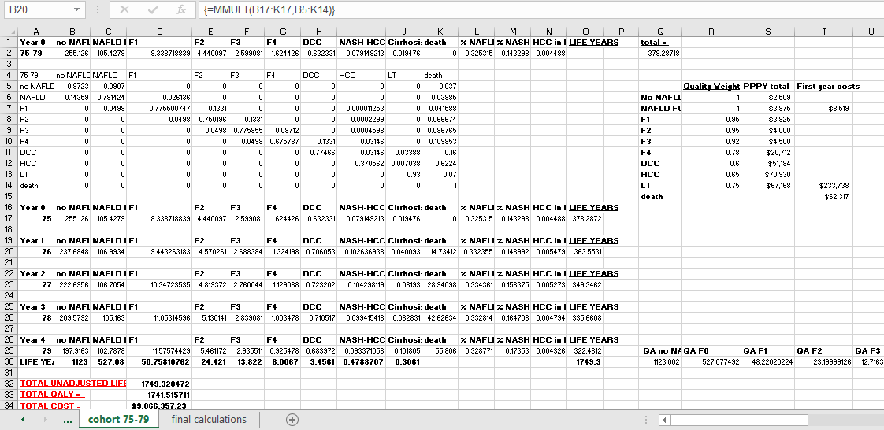
Markov Modeling in Excel

Slide 38
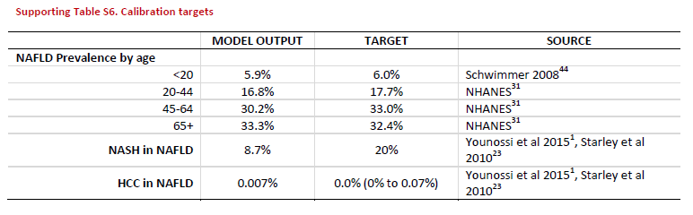
Model Calibration
Does not appear to be a consensus methodology for the calibration of Markov Models
Not clear that this was undertaken in many of the studies I reference
Mahady et al., 2012, Zhang et al., 2015, and Tapper et al., 2015
Estes et al., calibrated results to SEER for HCC incidence and mortality, but no other data
Younossi et al., 2015 in “The Economic and Clinical Burden of Non-Alcoholic Fatty Liver Disease in the United States” provides the most detailed method
Global criterion method – 7 step theoretical framework
“generalized reduced gradient nonlinear optimization routine”
SOLVER add-in for Excel

Slide 39
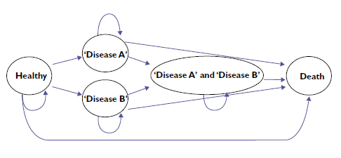
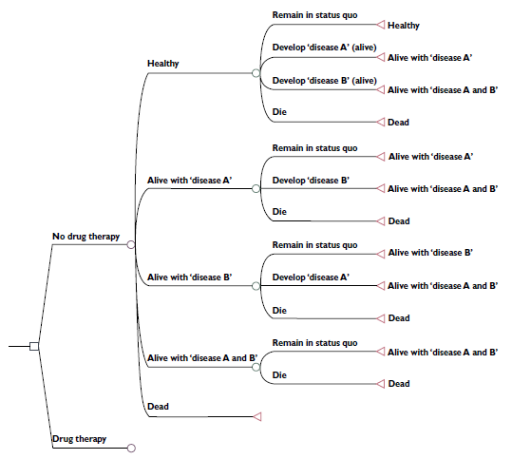
Multi-disease State Models
“The problem with the Markov assumption is especially prominant when more than one disease is being considered, because many diseases are inter-dependent and the probability of one is often affected by the prior occurrence of another.”
“Including as many health states as is required to capture important disease combinations, as is exemplified by Figures 3 and 4 can help overcome this issue. However, inclusion of too many health states into a Markov model can render it unwieldy. Paradoxically, a complex Markov model that attempts to reflect more accurately multiple related conditions may be subject to more uncertainty because of the need for more data inputs and assumptions to be made about them. For example, In Figures 3 and 4, transition probabilities need to be estimated for diseases A and B that are conditional on the presence or otherwise of the other disease.”
Is it possible to over-lay, rather than combine diseases, in separate disease models run with parallel inputs?
Notes:
Possible that Monte Carlo/using another software can make this more feasible
Modelling multiple disease states in the same Markov will require each combination of different disease states to be represented as its own transition state → could make the model unwieldy

Slide 40
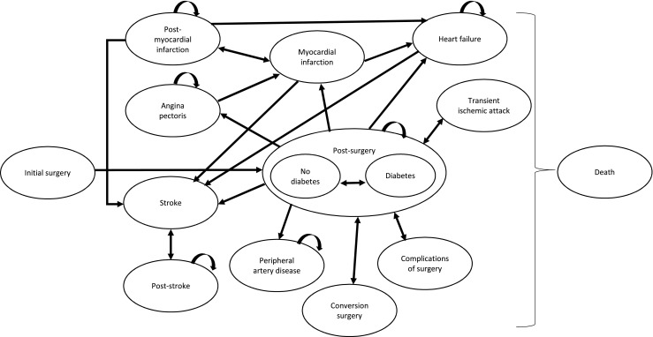
Multi-disease state model: Existing cost-utility models for bariatric surgery
Borisenko O, Mann O, Duprée A. Cost-utility analysis of bariatric surgery compared with conventional medical management in Germany: a decision analytic modeling. BMC Surgery. 2017;17:1-9.

